Slide 1
Java Script
Day 3

Slide 2
Objective
Arrow functions
Why?
Explain how the this keyword behaves in an arrow function
Optional, Named & Default values
REST parameters and the spread operator
JS Objects
Creating objects
Object Properties
Object methods
Enumerating object properties
De structuring syntax (array and object)
JS built-in objects (this can be given as a self study)
Array, Date, String, Math, Number

Slide 3
Objectives
Introducing the Document Object Model (DOM)
What is DOM? What is DOM manipulation?
The document object and their methods
Accessing & styling DOM elements
document.getElementByTagName(), document.getElementById(), etc., etc.
Event handling
on<<event name>>
addEventListener()
Differences between both
Showing and hiding DOM elements
Adding/removing DOM elements
JS window object and its methods
alert(), confirm()
Opening/Closing child windows

Slide 4

Optional Parameter
Why Optional Parameter?
We know java script is not type safe it means not checking type. Same it behaves with parameter values.
Java Script is also not checking for number of parameters while passing arguments.
So, in order to handle situation in given below example we need optional parameter.
Let’s understand it step by step
function displayNumbers(num1, num2, num3) {
console.log(num1, num2, num3);
}
displayNumbers(2, 3, 4);
displayNumbers(2, 3);
displayNumbers(2, 3, 4, 5, 6);

Slide 5
Optional Parameter
Here we will handle both conditions
Condition 1: If arguments less than parameters provided.
Condition 2: If arguments more than parameters.
Here we can handle this situation by two ways
Explicitly declare variable and assign vales.
Throws an error if arguments more than parameters.
function displayNumbers(num1, num2, num3) {
//handling condition 1
num3 = num3 || 20;
console.log(num1, num2, num3);
}
function displayNumbers(num1, num2, num3) {
//condition 2 way 1
var fourthVal = arguments[3];
var fifthVal = arguments[4];
console.log(fourthVal);
console.log(fifthVal);
}
function displayNumbers(num1, num2, num3) {
if (arguments.length < 3) {
throw new Error('Invalid number of Arguments')
}
}

Slide 6
Default Parameter
We know how to create a different types of functions.
Let’s consider given below example:
function displayEmpInfo(empName, empAge, empGender){
return `Employee Name =${empName}, Employee Age= ${empAge}, Employee Gender=${empGender}`
}
Console.log(displayEmpInfo());
What will be output of this ?

Slide 7
Default Parameter
In order to avoid such situations we can use default parameter values.
function displayEmpInfo(empName=‘No Name’, empAge=18, empGender=‘No Gender’){
return `Employee Name =${empName}, Employee Age= ${empAge}, Employee Gender=${empGender}`
}
console.log(displayEmpInfo());
console.log(displayEmpInfo('Kiran', 24, 'Male'));

Slide 8
Named Parameter
As name implies, this concept is very simple and clear.
Assume we have a function
function displayNumbers({ a, b, c }) {
console.log(a, b, c);
}
displayNumber(10,20,2);
So in this case we can say a=10,b=20,c=2 but we can’t say these arguments are specific for a, b, c respectively. If we will have n numbers of parameters, then how we can get to know which argument for which parameter because we are not going to provide value for respective parameter.
When our requirement is like this where we have to pass arguments for respective variable then we will have to use name of that parameter and provide values. Let’s understand with example.

Slide 9
Named Parameter
//Named Parameter
function displayNumbers({ a, b, c }) {
console.log(a, b, c);
}
//Way to call method with named parameter
displayNumbers({ b: 12, a: 32, c: 09 });

Slide 10
Object
Object is also a data structure in JS.
It is also use to save multiple relative values/ elements as key value pair.
Syntax for declaring object
Const stdinfo ={
key : value
ex.
firstName : ‘Bhushan’,
lastName : ‘XYZ’
};

Slide 11
Manipulate data of object using dot and bracket.
We can access properties in object using ( . ) or ( [ ] )
We can add more properties using . And [ ].

Slide 12
Manipulate data of object using dot and bracket.
//Creating Object and accessing properties and adding new properties
const tataNexon = {
//properties of objects
modelName:'Tata Nexon',
chesisNumber:123456,
carColor: 'Red',
carPrice: 13.5,
carFeature: 'Electric Vehicle',
yearOfMan:2022
}
console.log(tataNexon.modelName+'-'+tataNexon.chesisNumber);
tataNexon.carColor='blue';
console.log(tataNexon.carColor);
console.log(tataNexon.chesisNumber+"-"+tataNexon.carColor+"-"+tataNexon.carPrice);
tataNexon.carColor="blue";
console.log(tataNexon.chesisNumber+"-"+tataNexon.carColor+"-"+tataNexon.carPrice);
console.log(tataNexon['chesisNumber']+"--"+tataNexon['carColor']+"--"+tataNexon['carPrice']);
tataNexon['carColor']='white';
console.log(tataNexon['chesisNumber']+"--"+tataNexon['carColor']+"--"+tataNexon['carPrice']);

Slide 13
Manipulate data of object using dot and bracket.
//add additional property using []
tataNexon['carSegment']="Compac SUV";
console.log(tataNexon['chesisNumber']+"--"+tataNexon['carColor']+"--"+tataNexon['carPrice']
+"--"+tataNexon['carSegment']);
//add additional property using .
tataNexon.carWeight=1200;
console.log(tataNexon['chesisNumber']+"--"+tataNexon['carColor']+"--"+tataNexon['carPrice']
+"--"+tataNexon.carWeight);

Slide 14
Methods in Java Script Object
For any Object we can create a method inside it. For example:
const Batch1Folks ={
first_name:’Hritik',
last_name:'Kumar',
ct_id:101,
full_name:function(){
return this.first_name+" "+this.last_name;
}
}

Slide 15
What is “this”?
In JavaScript, the this keyword refers to an object.
Which object depends on how this is being invoked (used or called).
The this keyword refers to different objects depending on how it is used:
In an object method, this refers to the object.
Alone, this refers to the global object.
In a function, this refers to the global object.
In a function, in strict mode, this is undefined.
In an event, this refers to the element that received the event.

Slide 16
Calling Object Method
//Object Oriented Methods
const Batch2Folks ={
first_name:'Yash',
last_name:'Kumar',
ct_id:101,
year_of_birth:2000,
full_name:function(){
return this.first_name+" "+this.last_name;
},
age_of_student:function(){
return 2022-this.year_of_birth
}
}
//Accessing Object methods
let fName = Batch2Folks.full_name();
let tAge = Batch2Folks.age_of_student();
console.log(`Trainees Full Name = ${fName}`);
console.log(`Trainees age = ${tAge}`);

Slide 17
Object Properties
Object Property types
JavaScript specifies the characteristics of properties of objects via internal attributes surrounded by the two pairs of square brackets.
Objects have two types of properties: data and accessor properties.

Slide 18
Data properties
A data property contains a single location for a data value. A data property has four attributes:
[[Configurarable]] – determines whether a property can be redefined or removed via delete operator.
[[Enumerable]] – indicates if a property can be returned in the for...in loop.
[[Writable]] – specifies that the value of a property can be changed.
[[Value]] – contains the actual value of a property.
By default, the [[Configurable]] , [[Enumerable]]And [[Writable]] attributes set to true for all properties defined directly on an object. The default value of the[[Value]] attribute is undefined.
The following example creates a person object with two properties firstName and lastName with the configurable, enumerable, and writable attributes set to true. And their values are set to ‘James' and ‘Cameron' respectively:
let person = {
firstName: ‘James',
lastName: ‘Cameron'
};

Slide 19
Enumerating object properties
How to change any attribute of any property, we can use “Object.defineProperty()” method.
The Object.defineProperty() method accepts three arguments:
An object.
A property name of the object.
A property descriptor object that has four properties: configurable, enumerable, writable, and value.
Note: -
If you use the Object.defineProperty() method to define a property of the object, the default values of [[Configurable]], [[Enumerable]], and [[Writable]] are set to false unless otherwise specified.

Slide 20
Understand it with Example
//Enumerable with default configuration
let person={
ename:'John',
eaddress:'Mumbai'
} person.age=24;
console.log("Person Details ="+person.ename+"-"+person.age);
// We are able to delete property delete person.age
console.log("Person Details ="+person.ename+"-"+person.age);

Slide 21
Change value of Configurable
The following example creates a person object and adds the salary property to it using the Object.defineProperty() method:
'use strict';
//Defining Object
let person={
ename:'John',
eaddress:'Mumbai’
}
//Add new property using Object.defineProperty() method.
Object.defineProperty(person, 'salary',{
configurable:false,
value:5000
});
delete person.salary;

Slide 22
Change value of Configurable
'use strict’; (Same example )
//Defining Object
let person={
ename:'John',
eaddress:'Mumbai’
}
//Add new property using Object.defineProperty() method.
Object.defineProperty(person, 'salary',{
configurable:false,
value:5000
});
delete person.salary;
Note: In this example, the configurable attribute is set to false. therefore, deleting the salary property causes an error.
Also, once you define a property as non-configurable, you cannot change it to configurable.

Slide 23

Change value of Configurable
Object.defineProperty(person, 'salary',{
configurable:false,
value:5000
});
Object.defineProperty(person, 'salary',{
configurable:true
});
It will throws us an error:
Note: We can’t set Configurable to true if we already define it false earlier. Otherwise it will throws us error.

Slide 24
Enumerable attribute
By default, the enumerable attribute of all the properties defined on an object is true. t means that you can iterate over all object properties using the for...in loop like this:
'use strict';
//Enumerable
let person={
ename:'John',
eaddress:'Mumbai'
}
for (const key in person) {
console.log(key);
}

Slide 25
Enumerable attribute
Consider the same example as previous and then use
Object.defineProperty(person, ‘eaddress', { enumerable: false });
'use strict';
//Enumerable
let person={
ename:'John',
eaddress:'Mumbai'
}
for (const key in person) {
console.log(key);
}
Object.defineProperty(person,'eaddress',{
enumerable:false
});
for (const key in person) {
console.log(key);
}
Note: In second loop, it is not going to display us property eaddress, because we have set enumerable:false.

Slide 26
Define multiple properties: Object.defineProperties()
In ES5, you can define multiple properties in a single statement using the Object.defineProperties() method. or example:
'use strict'
let Employee={};
Object.defineProperties(Employee,{
ename:{
value:'Tom'
},
eaddress:{
value:'Mumbai'
}
});
console.log("------------Employees-----------------");
console.log(Employee.ename+"--"+Employee.eaddress);
console.log('-------------------------------------’);
For more Details: https://www.javascripttutorial.net/javascript-object-properties/

Slide 27
How to Use Object Destructuring in JavaScript
The object destructuring is a useful JavaScript feature to extract properties from objects and bind them to variables.
What's better, object destructuring can extract multiple properties in one statement, can access properties from nested objects, and can set a default value if the property doesn't exist.

Slide 28
The need for object destructuring
Before ES2015, If we had to assign values of object properties to variables then we had to write given below code:
//Pre ES2015
let employee ={
emp_name:'Bhushan',
emp_Id:101
};
let emp_name=employee.emp_name;
let emp_Id =employee.emp_Id;
The property employee.emp_name value is assigned to the variable eName. Same way employee.emp_Id value is assigned to eId.
Such a way to access properties and assign them to variables requires boilerplate code. By writing let eName=employee.emp_name; , you have to mention the name binding 2 times, and the same for emp_Id.
That's where the object destructuring syntax is useful: you can read a property and assign its value to a variable without duplicating the property name. More than that, you can read multiple properties from the same object in just one statement!

Slide 29
The need for object destructuring
Object destructuring Example:
let employee ={
emp_name:'Bhushan',
emp_Id:101
};
let {emp_name,emp_Id} = employee;
console.log(emp_name);
console.log(emp_Id);
Note: let {emp_name, emp_Id } = employee is an object destructuring assignment. This statement defines the variables emp_name and emp_Id , then assigns to them the values of properties employee.emp_name
and employee.emp_Id correspondigly.
Comparing the 2 approaches to access the object properties:
let eName=employee.emp_name;
let eId=employee.emp_Id;
// is equivalent to:
let {emp_name,emp_Id} = employee;
it's visible that the object destructuring is handier because neither the property names nor the object variable is duplicated.

Slide 30
Extracting a property
The basic syntax of object destructuring is pretty simple:
const { identifier } = expression;
Where identifier is the name of the property to access and expression should evaluate to an object. After the destructuring, the variable identifier contains the property value.
Here's the equivalent code using a property accessor:
const identifier = expression.identifier;

Slide 31
Examples For Destructuring
Example 1:
//single Property
let student={
st_name:'John'
}
let {st_name}=student;
console.log(st_name);
Example 2:
//Multiple Properties
let employee ={
emp_name:'Bhushan',
emp_Id:101
};
let {emp_name,emp_Id} = employee;
console.log(emp_name);
console.log(emp_Id);

Slide 32
Rest parameter and spread operator in JavaScript
In Javascript both spread operator and rest parameter have the same syntax which is three dots(…). Even though they have the same syntax they differ in functions.
Spread operator: The spread operator helps us expand an iterable such as an array where multiple arguments are needed, it also helps to expand the object expressions. In cases where we require all the elements of an iterable or object to help us achieve a task, we use a spread operator.
Note: There can be more than one spread operator in javascript functions.
Syntax:
var var_name = [...iterable];

Slide 33
Rest parameter and spread operator in JavaScript
Example: Spread Operator:
<script>
var array1 = [10, 20, 30, 40, 50];
var array2 = [60, 70, 80, 90, 100];
var array3 = [...array1, ...array2];
console.log(array3);
</script>
Output:[10, 20, 30, 40, 50, 60, 70, 80, 90, 100]

Slide 34
Rest parameter and spread operator in JavaScript
Example2: Spread Operator:
<script>
var array1 = [10, 20, 30, 40, 50];
var array2 = [...array1, 60];
console.log(array2);
</script>
Output: [10, 20, 30, 40, 50, 60]

Slide 35
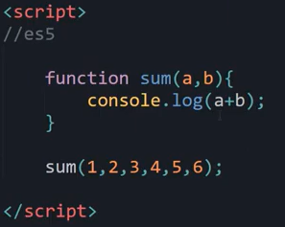
Rest parameter and spread operator in JavaScript
Rest Operator: It is improved way to handle function parameters. It allows us to handle various input as parameters in function.
“The Rest Parameter syntax allows us to represent an indefinite number of arguments as an array”.
Let’s understand how we perform some operations in ES5:
But if we have to accommodate all arguments we will
have to modify function and add that number of
parameters. But what if we don’t know number of
arguments? For such kind of scenarios we have rest
Parameters.

Slide 36
Rest Parameter
Example 1:
function additionOfNumbers(...numbers) {
console.log(numbers);
let total = 0;
for (const i of numbers) {
total += i;
}
console.log(total);
}
additionOfNumbers(1, 2, 3, 4, 5, 6, 10);

Slide 37
Rest Parameter
Example 2:
function displayPlayersName(a, b, ...c) {
console.log(`${a} ${b}`);
console.log(c);
console.log(c[0]);
console.log(c.length);
console.log(c.indexOf('Sachin')); }
displayPlayersName('Suresh', 'Rohit', 'Virat', 'Sachin', 'Irfan')

Slide 38
JS built-in objects
Built-in Objects
Built-in objects are not related to any Window or DOM object model.
These objects are used for simple data processing in the JavaScript.
For details visit:
https://www.tutorialride.com/javascript/javascript-built-in-objects.htm

Slide 39
Date Function
JavaScript supports date and time formatting function.
Date() function object contains a long list of methods that can be used to manipulate the date.
If there won’t be any other function applied then it will log a date value as long value in localized format.
(GMT- Greenwich mean time)
(UTC – Coordinated Universal Time)

Slide 40
Creating Date Objects
Commonly there are four ways to define date object.
new Date();
new Date(year, month, date, hour, minute, seconds, millisecond);
new Date(millisecond);
new Date(date string);

Slide 41
Date Format
ISO date -"2015-03-25" (The International Standard)
Short Date - "03/25/2015“
Long Date - "Mar 25 2015" or "25 Mar 2015"

Slide 42
Get Date Methods
Method | Description
getFullYear() | Get the year as a four digit number (yyyy)
getMonth() | Get the month as a number (0-11)
getDate() | Get the day as a number (1-31)
getHours() | Get the hour (0-23)
getMinutes() | Get the minute (0-59)
getSeconds() | Get the second (0-59)
getMilliseconds() | Get the millisecond (0-999)
getTime() | Get the time (milliseconds since January 1, 1970)
getDay() | Get the weekday as a number (0-6)
Date.now() | Get the time. ECMAScript 5.

Slide 43
Set Date Methods
Method | Description
setDate() | Set the day as a number (1-31)
setFullYear() | Set the year (optionally month and day)
setHours() | Set the hour (0-23)
setMilliseconds() | Set the milliseconds (0-999)
setMinutes() | Set the minutes (0-59)
setMonth() | Set the month (0-11)
setSeconds() | Set the seconds (0-59)
setTime() | Set the time (milliseconds since January 1, 1970)

Slide 44
Example for Date
Example 1:
// way 1 without any parameter
//Output will be current date and time as per local time zone
const currentDate = new Date();
console.log(currentDate);
// Way 2 with parameters
const myDate = new Date(2020,11,24,10,34,45,45);
console.log(myDate);
// // In js months count is starting from 0 and ending with 11
// //Example - If I want to specify Jan then I will have to use 0 .

Slide 45
Example for Date
Example 2:
// // when I am going to use object creation with one parameter as milisecond then
// //it is going to consider zero date and time and milisecons will be added to that zero date and time value.
const d = new Date(10000000);
console.log(d);
// // This is just going to provide three parameters 1. year 2. month 3. day
const d1 = new Date(2018,1,3);
console.log(d1);
// // paramater as string for date value
const d2 = new Date("October 12 2021 11:30:23");
console.log(d2);
// // another way to add string parameter as date
const d3 = new Date("12 october 2021 ,11:30:23 ");
console.log(d3);
// //
const d4 = new Date("11-10-2021,11:30:23 ");
console.log(d4);
console.log( typeof d4);
console.log(typeof d4.toString());
const d5 = new Date("14 sep 2014 12:20:01 ");
console.log(d5);

Slide 46
Formatting Dates
//formatting dates
const t = new Date("2021-10-14");
const t2 = new Date("2021-10");
const t3= new Date("2021");
const t4 = new Date("03/21/2011");
const t5 = new Date("Mar 25 2015");
console.log(t);
console.log(t2);
console.log(t3);
console.log(t4);
console.log(t5);

Slide 47
Methods for working with Dates Getter methods
const mycurrentDate = new Date();
console.log(mycurrentDate);
// display year
console.log(mycurrentDate.getFullYear());
console.log(mycurrentDate.getMonth());
console.log(mycurrentDate.getHours());
console.log(mycurrentDate.getMinutes());
console.log(mycurrentDate.getSeconds());
console.log(mycurrentDate.getMilliseconds());
console.log(mycurrentDate.getTime());

Slide 48
Methods of Date “Setter methods”
const mycurrentDate = new Date();
mycurrentDate.setFullYear(2022);
console.log(mycurrentDate);
mycurrentDate.setMonth(09);
console.log(mycurrentDate);
mycurrentDate.setHours(09);
console.log(mycurrentDate);
console.log(Date.now());
console.log("Welcome Bhushan "+mycurrentDate);

Slide 49
String Methods in JS
There are some methods for manipulating string.
Length()
Slice(start , end)
Substring(start , end);
Substr( start , end);
Replace(oldvalue , newValue);
toUpperCase() and toLowerCase()
Concat()
Trim()
charAt()

Slide 50
String methods
const empName = "Bhushan";
console.log(empName.length);
const empName1 = " Bhushan ";
console.log(empName1.trim().length);
console.log(empName.toUpperCase());
console.log(empName.toLowerCase());
const empFullName= empName.concat(" Kumar");
console.log(empFullName);
console.log(empName.replace("Bhushan","Rakshit"));
console.log(empName.charAt(2));
console.log(empName.slice(0,3));
console.log(empName.substring(2,6));
console.log(empName.substr(2,2));

Slide 51
Number Methods
The toString() Method → The toString() method returns anumber as a string
toFixed() Method →returns a string, with the number written with a specified number of decimals:
valueOf() returns a number as a number.
Number() -can be used to convert JavaScript variables to numbers:
parseInt() parses a string and returns a whole number.
parseFloat() parses a string and returns a number.

Slide 52
Number methods
//Numbers
const num1=512;
console.log(typeof num1);
console.log(typeof num1.toString());
console.log(typeof (500-348-2+23).toString());
const num2 = 56.87837483;
console.log(num2);
console.log(num2.toFixed(2));
console.log(num2.toFixed(4));
const num3 = 200;
console.log(num3.valueOf());
console.log((54*23+5653).valueOf());
console.log(Number(true));
console.log(Number(false));
console.log(parseInt(345.644343));
console.log(parseInt("1234"));
console.log(typeof parseFloat("1234"));
console.log(parseFloat(345.644343));

Slide 53
Out of TOC
Understanding of Class:
We have seen concept of Class and object in our Programming concept training. We will try to implement class and respective object.
Scenario→ We have to create a class as Batch2Folks which will have respective characteristics and their behavior.
class Batch2Folks {
ct_id;
emp_name;
emp_phone;
constructor(ct_id, emp_name, emp_phone) {
this.ct_id = ct_id;
this.emp_name = emp_name;
this.emp_phone = emp_phone;
}
}
displayInfo() {
document.write(`----------------Employee Info----------------<br/>`);
document.write(`</br>ID of Employee=${this.ct_id} </br> Name of Employee ${this.emp_name}</br> Phone of Employee =${this.emp_phone}</br>`);
document.write(`-------------------------------------------<br/>`)
}
submitAssignments() {
document.write(`</br>${this.emp_name} Submits assignments Everyday at 6pm</br>`)
}

Slide 54
Class Batch2Folks
class Batch2Folks {
ct_id;
emp_name;
emp_phone;
constructor(ct_id, emp_name, emp_phone) {
this.ct_id = ct_id;
this.emp_name = emp_name;
this.emp_phone = emp_phone;
}
displayInfo() {
document.write(`----------------Employee Info----------------<br/>`);
document.write(`</br>ID of Employee=${this.ct_id} </br> Name of Employee
${this.emp_name}</br> Phone of Employee =${this.emp_phone}</br>`);
document.write(`-------------------------------------------<br/>`);
}
submitAssignments() {
document.write(`</br>${this.emp_name} Submits assignments Everyday at 6pm</br>`);
}
}

Slide 55
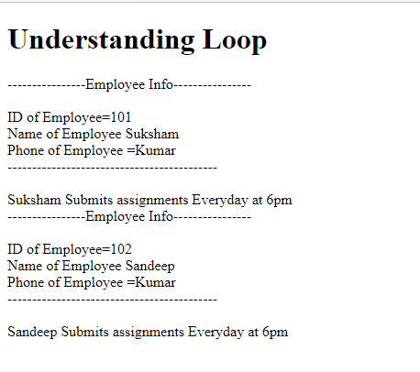
Class Batch2Folks
Creating Objects and calling methods of class with respect to Objects.
var emp1 = new Batch2Folks(101, 'Suksham', 'Kumar');
var emp2 = new Batch2Folks(102, 'Sandeep', 'Kumar');
emp1.displayInfo();
emp1.submitAssignments();
emp2.displayInfo();
emp2.submitAssignments();
Output will be:

Slide 56
DOM
DOM stands for Document object model
It is structured representation of HTML document allows JS to access HTML elements , style them to manipulate.
Make a note
that Entry point for DOM is document
Anything which present in HTML document can be access using DOM.

Slide 57
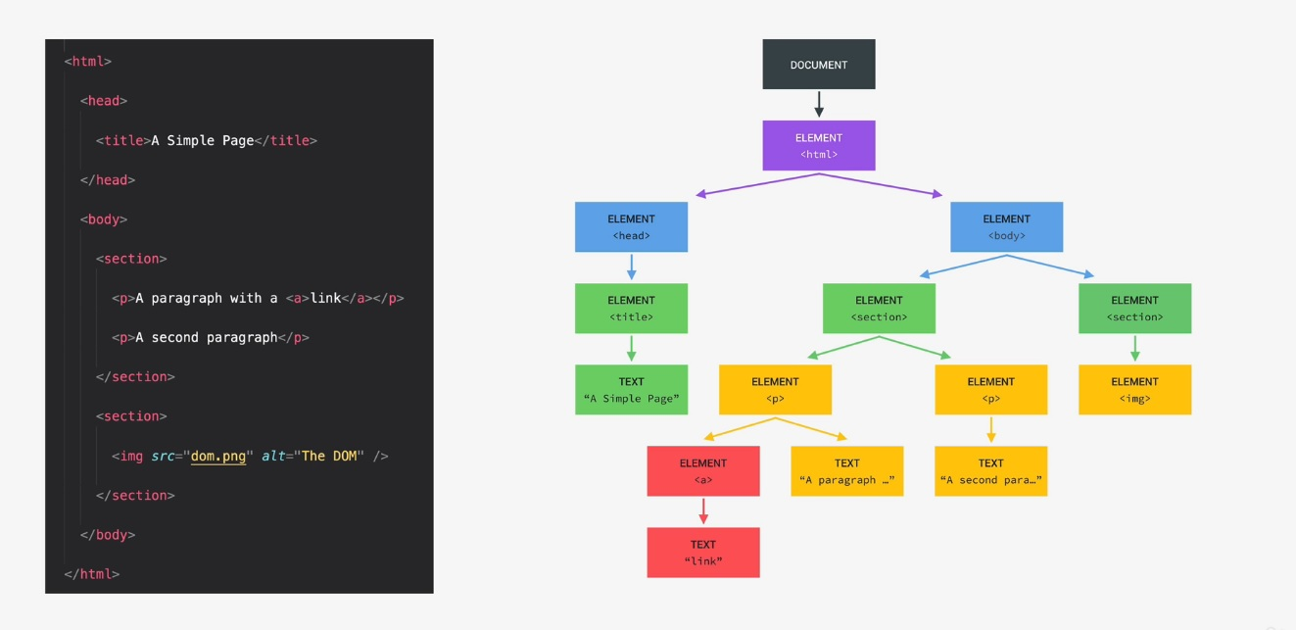

Slide 58
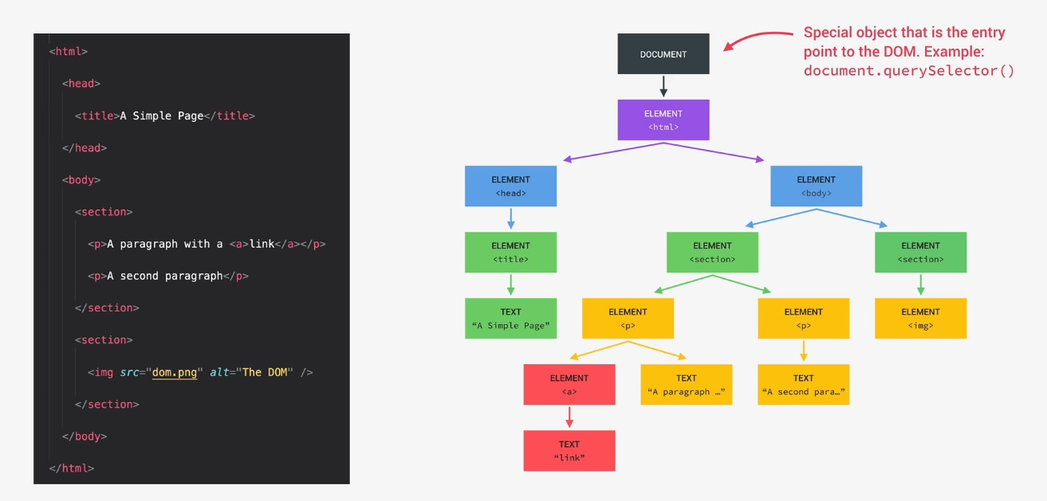

Slide 59
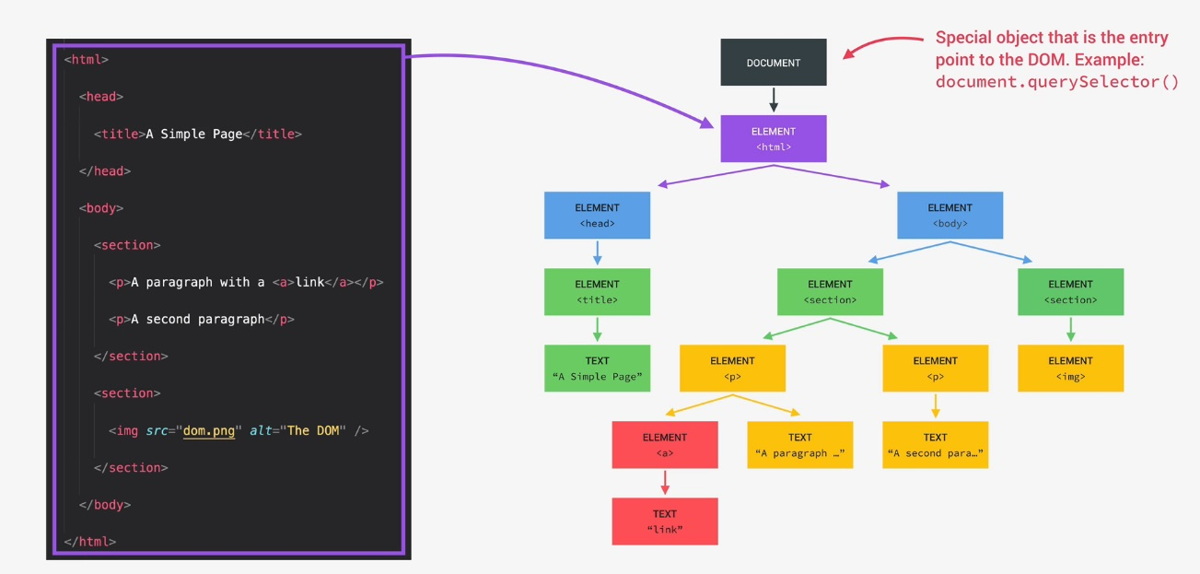

Slide 60
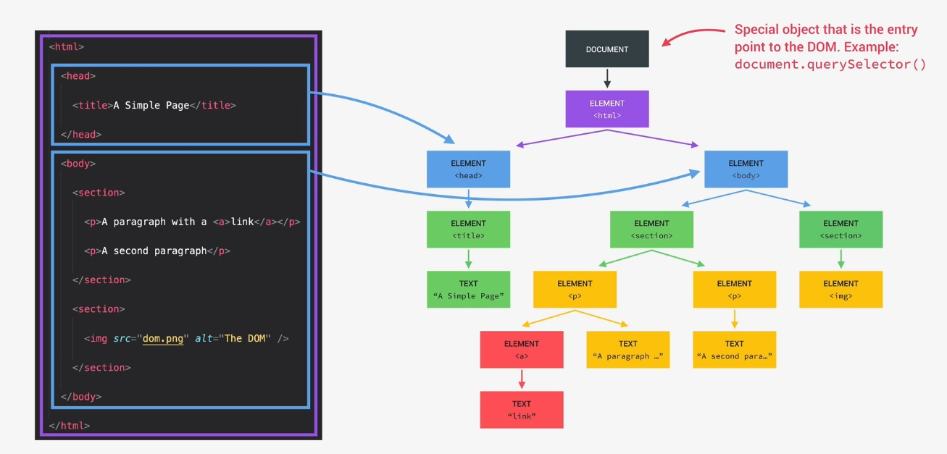

Slide 61
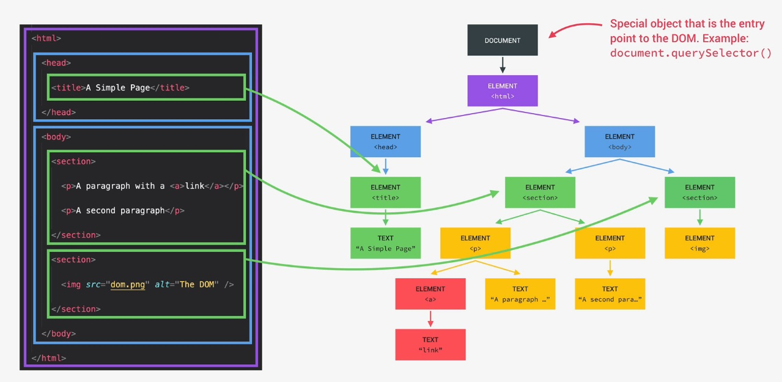

Slide 62
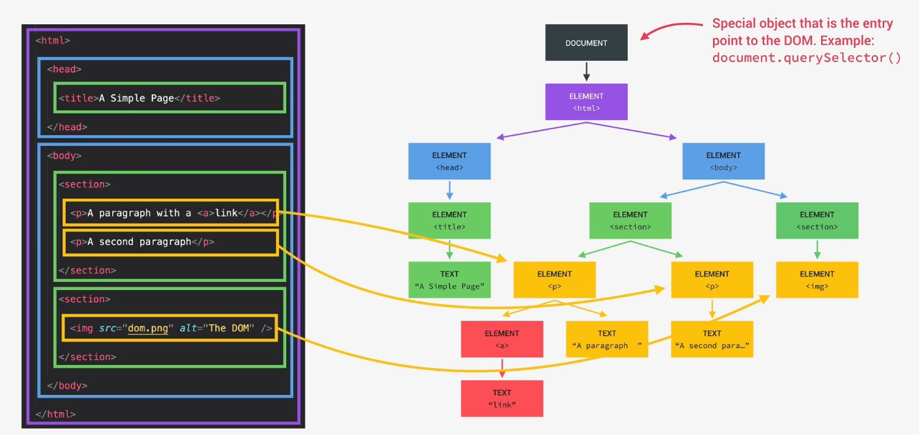

Slide 63
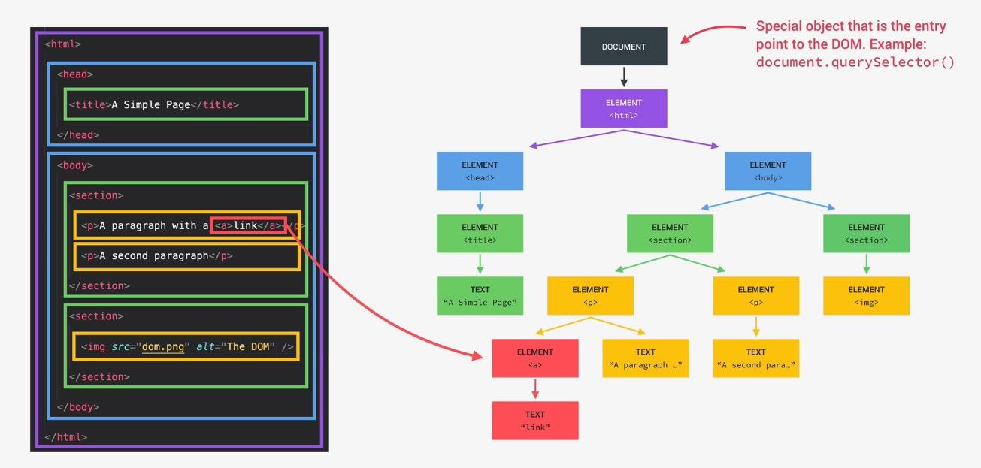

Slide 64
DOM understanding
let val = document.querySelector('h1').innerHTML;
console.log(val);
let val1 = document.getElementsByTagName('h1')[0].innerHTML;
console.log(val1);
let val2 = document.getElementById('h1id').innerHTML;
console.log(val2);

